Slide 1

Algorithms and Data Structures 1 CS 0445
Fall 2023
Backtracking
Sherif Khattab
ksm73@pitt.edu
(Slides are adapted from Dr. Ramirez’s and Dr. Farnan’s CS1501 slides.)

Slide 2
Announcements
Upcoming Deadlines:
Lab 4: Friday 10/27 @ 11:59 pm
Homework 7: Tuesday 10/31 @ 11:59 pm
Programming Assignment 3: Friday 11/3 @ 11:59 pm
Midterm grades are out
Please check your exam paper on GradeScope
Question reattempts open until 11/7 @ 11:59 pm
Regrade Request feature on GradeScope
Can get up to 7 points back
Correction of T/F questions must have a non-trivial explanation
Lost points in a lab assignment because of the autograder or a simple mistake?
please reach out to Grader TA over Piazza

Slide 3
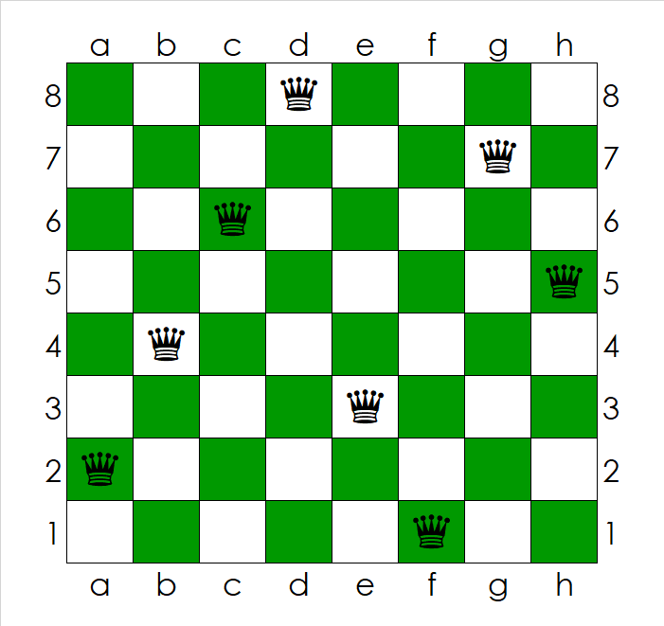
Eight Queens Problem
Place eight queens on a chessboard so no queen can take any other in the next move?
A Queen in chess can move horizontally, vertically, or diagonally for multiple spaces
Encik Tekateki, CC BY-SA 4.0, via Wikimedia Commons

Slide 4
Recursive Solution for Eight Queens
Define the problem at hand
Input: N, the dimension of the chess board and the number of queens
Output: Eight positions of the queens
Find a Base Case:
Placing the 8th Queen
Place 8th queen in a safe square in 8th column
If possible, solution and report solution found; otherwise, report no solution
Define a Recursive Case:
Friend can place queens starting from ith queen (i > 1)
Place “1st queen” in a safe square in “1st column” then ask friend to solve subproblem starting from “2nd queen”
If friend reports no solution, replace “1st queen” if possible and repeat
If friend reports a solution, return solution found
Revisit the inputs
Input: starting queen number
Output: a Boolean indicating if solution found

Slide 5
Backtracking to solve 8 Queens
Idea of backtracking:
Recursive case may need to try different options
Place starting queen in a safe square on corresponding column
make a recursive call to place queens from starting > 1
if the result is no solution, replace the queen at a different safe square if possible
make a recursive call, etc.
Proceed forward to a solution until it becomes apparent that no solution can be achieved along the current path
At that point UNDO the solution (backtrack) to a point where we can again proceed forward

Slide 6
8 Queens Problem
Check JRQueens.java in code handouts
Idea of solution:
Each recursive call placeQueensStartingFrom attempts to place queens starting from queenNo
A loop is used to try all possible squares on corresponding column
8 squares in the column
For a given call, the state of the board from previous placements is known (i.e., where are the other queens placed so far?)
This is used to determine if a square is safe or not
If a placement within the column does not lead to a solution, the queen is removed and moved "down" the column
When all squares in a column have been tried, the call terminates and backtracks to the previous call (in the previous column)
If a queen cannot be placed into column i, do not even try to place one onto column i+1 – rather, backtrack to column i-1 and move the queen that had been placed there

Slide 7
8 Queens Problem
Why is this difficult to do iteratively?
We need to store a lot of state information as we try (and un-try) many locations on the board
For each column so far, where has a queen been placed?
The run-time stack does this automatically for us via activation records
Without recursion, we would need to store and update this information ourselves
This can be done (using our own Stack rather than the run-time stack), but since the mechanism is already built into recursive programming, why not utilize it?
There are many other famous backtracking problems
PIN Cracking
Sudoku
Check Backtracking .java
http://en.wikipedia.org/wiki/Backtracking

Slide 8
Checking if a Square is safe
Three boolean arrays
One for rows (8 rows)
One for right diagonals (15 diagonals)
One for left diagonals (15 diagonals)

Slide 9
Right Diagonals
Right diagonal no. = row + col
8
0
Q
9
10
1
Q
0
11
2
Q
(2, 3)
1
12
3
Q
2
4
Q
13
3
5
(5, 6)
4
14
6
(6, 2)
5
7
Q
6
7
0
1
2
3
4
5
6
7

Slide 10
Left Diagonals
Left diagonal no. = 7 + (row - col)
8
0
Q
9
Q
0
1
10
2
Q
(2, 3)
1
11
3
Q
2
12
4
Q
3
13
5
(5, 6)
4
6
(6, 2)
14
7
Q
5
6
0
1
2
3
4
5
6
7
7

Slide 11
Eight Queens: Find all solutions
Base Case:
Placing the 8th Queen
Place 8th queen in all safe square in 8th column
Print each solution found
Recursive Case:
Friend can place queens starting from ith queen (i > 1)
Place “1st queen” in all safe square in “1st column” and ask friend to solve subproblem starting from “2nd queen” for each safe square
Revisit the inputs
Input: starting queen number
Output: No output needed

Slide 12
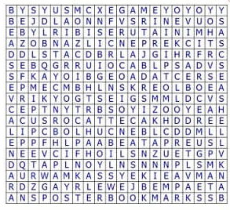
Word Search Problem
Find a given word in a grid of letters
may change direction in the middle of the word
Up to 8 possible directions:
Cannot use the same square twice
Example: PIPE
Example: TOY
Example: PEN
https://www.word-game-world.com/print-out-word-search.html

Slide 13
Recursive Solution for Word Search
Define the problem at hand
Input: a word to search for and a letter grid
Output: positions of the adjacent word letters in the letter grid
Base Case:
Finding the last letter in a legal square
Try all eight directions from previous letter
If letter already used, skip that direction
If last letter found, print solution and report solution found; otherwise, return not found
Recursive Case:
Friend can find sub-word (from a given letter) starting from a given square in grid
Find “1st letter” in a legal square
Then ask friend to solve subproblem from “2nd letter” and “1st letter”’s square
Friend reports no solution -> find another legal square for “1st letter” if possible and repeat
Friend reports a solution, return solution found
Revisit the inputs and output
Inputs: starting letter number and starting square’s row and column
Output: a Boolean indicating if solution found

Slide 14
Checking legal squares
For the 1st letter, all squares in the grid are legal
For subsequent letters,
Squares adjacent to previous square are legal
previously used squares are not legal

Slide 15
Word Search: Find all solutions
Base Case:
Finding the last letter in all legal square
Try all eight directions from previous letter
If letter already used, skip that direction
If last letter found, print solution and continue
Recursive Case:
Friend can find sub-word (from a given letter) starting from a given square in grid
Find “1st letter” in all legal squares
Ask friend to solve subproblem from “2nd letter” and “1st letter”’s square
Find another legal square for “1st letter” if possible and repeat
Revisit the inputs and output
Inputs: starting letter number and starting square’s row and column
Output: No output needed

Slide 16
Backtracking Framework: find all solutions
void solve(current decision, partial solution) {
for each choice at the current decision {
if choice is valid {
apply choice to partial solution
if partial solution a valid solution
report partial solution as a final solution
if more decisions possible
solve(next decision, updated partial solution)
undo changes to partial solution
}
}
}

Slide 17
Backtracking Algorithm for Word Search
void solve(row and column of current cell, word and letter no.) {
for each of the eight neighbors { //why 8?
if inside the grid and hasn’t been used and == word[letter no.] {
mark neighbor as used
if last letter
print solution
else
solve(row and column of neighbor, word and letter no. + 1)
unmark the neighbor
}
}
}

Slide 18
Backtracking Algorithm for Word Search
Need to call solve on each cell in the grid

